Slide 1
OLADIMEJI ALABI’s Capstone Project Presentation
Deploy a VNet-Based Multi-Tier Architecture with Secure Access Control
Group 5 – Azure CLI Automation & GitHub Integration https://github.com/Dimeji278/MultiTier-Project.git

Slide 2
Project Overview
Objective: Deploy a secure multi-tier architecture on Azure using CLI scripts.
Components: VNet, Subnets, NSGs, Linux VMs
Tools: Azure CLI, Bash, GitHub, SSH
Goal: Automate infrastructure setup and validate access control.

Slide 3
Step 1: Network Infrastructure Setup
Created Resource Group: Group5-MultiTier-RG
Defined VNet: Group5-VNet (10.0.0.0/16)
Subnets: Web (10.0.1.0/24), App (10.0.2.0/24), DB (10.0.3.0/24)
Script Used: init-network-infra.sh

Slide 4
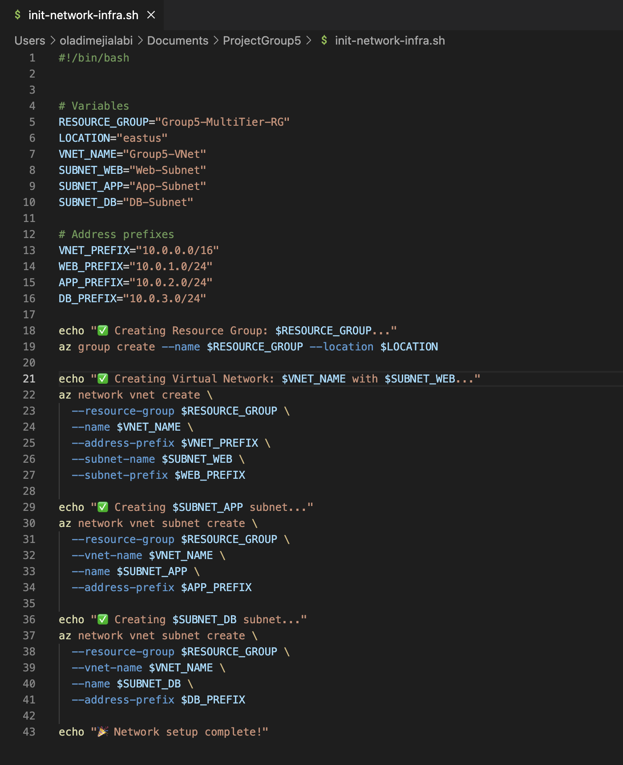

Slide 5
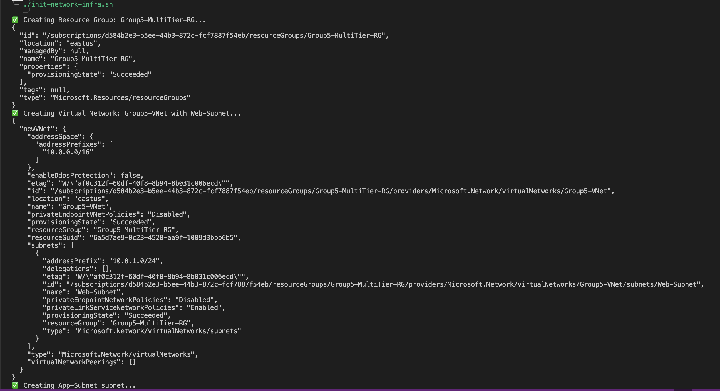

Slide 6
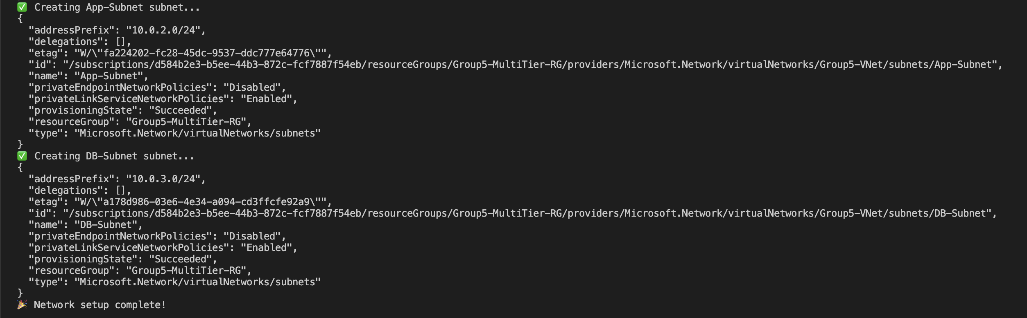

Slide 7
Step 2: NSG Configuration
Created NSGs for Web, App, and DB tiers
Set rules: Web → App (port 22), App → DB (port 3306)
Associated NSGs with respective subnets
Next Script: configure-nsgs.sh

Slide 8
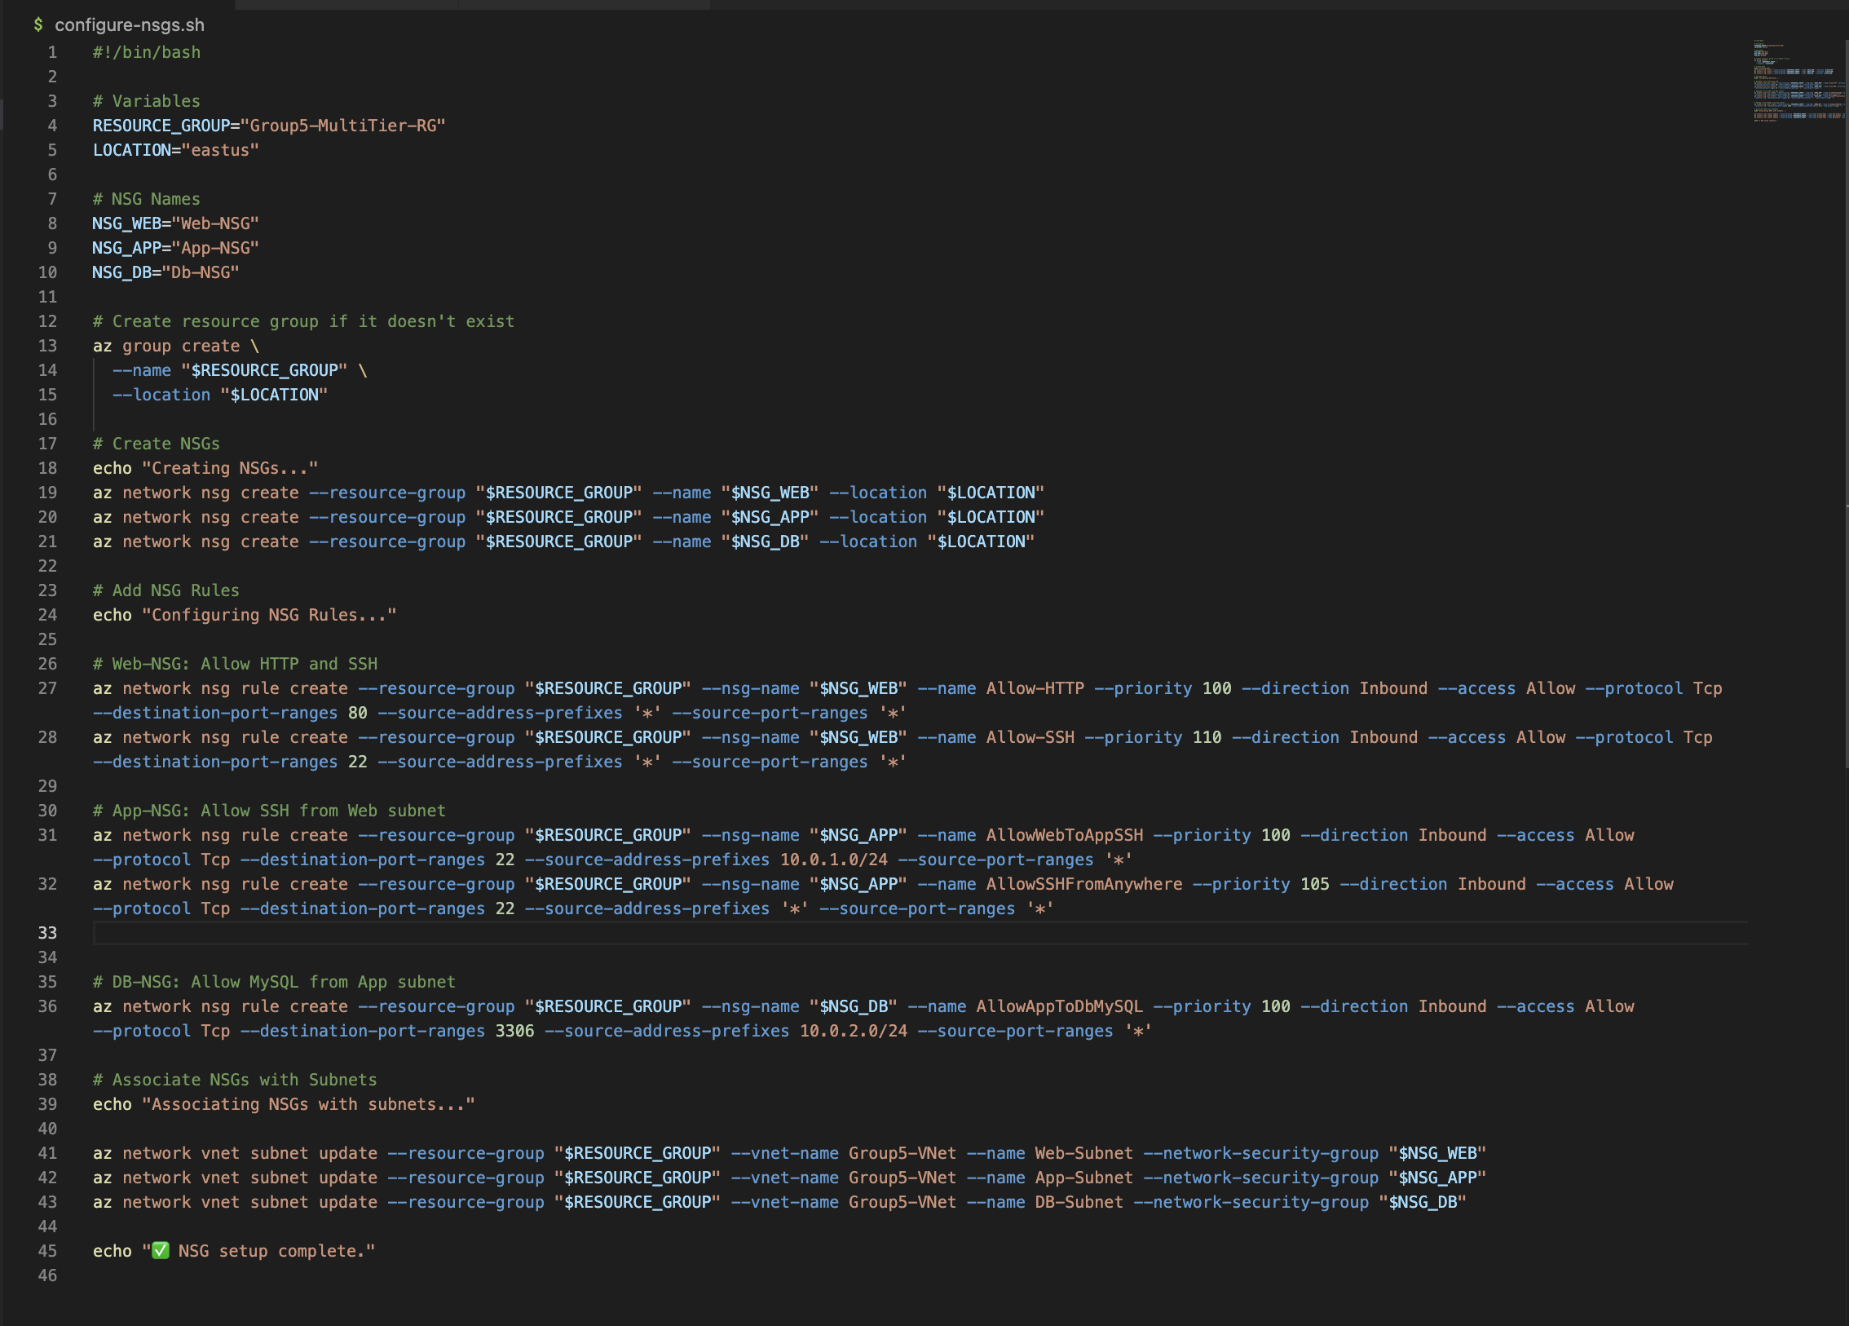

Slide 9
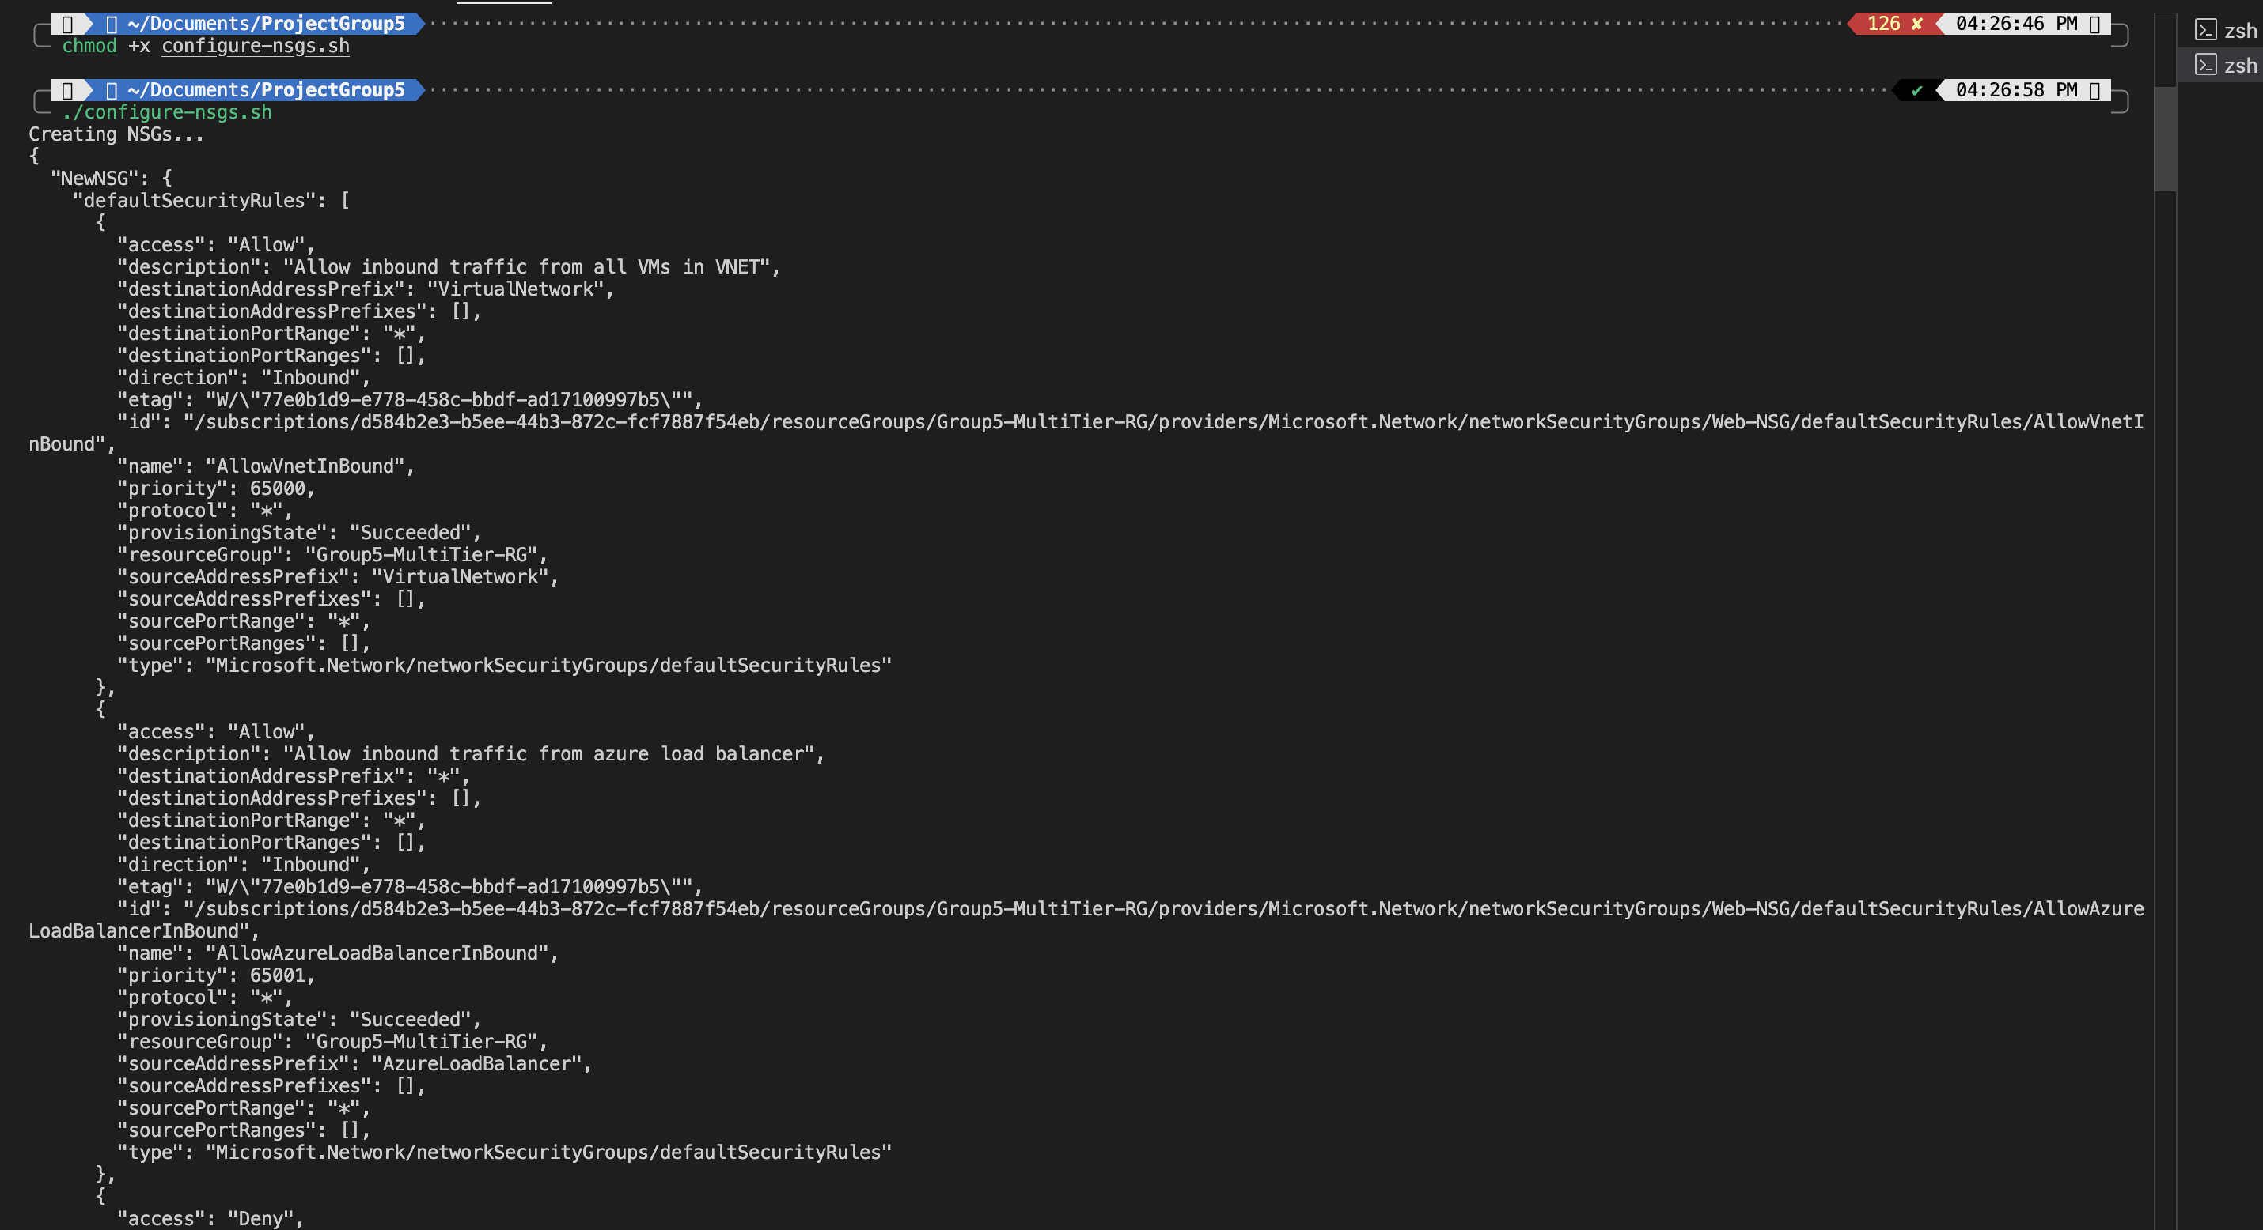

Slide 10
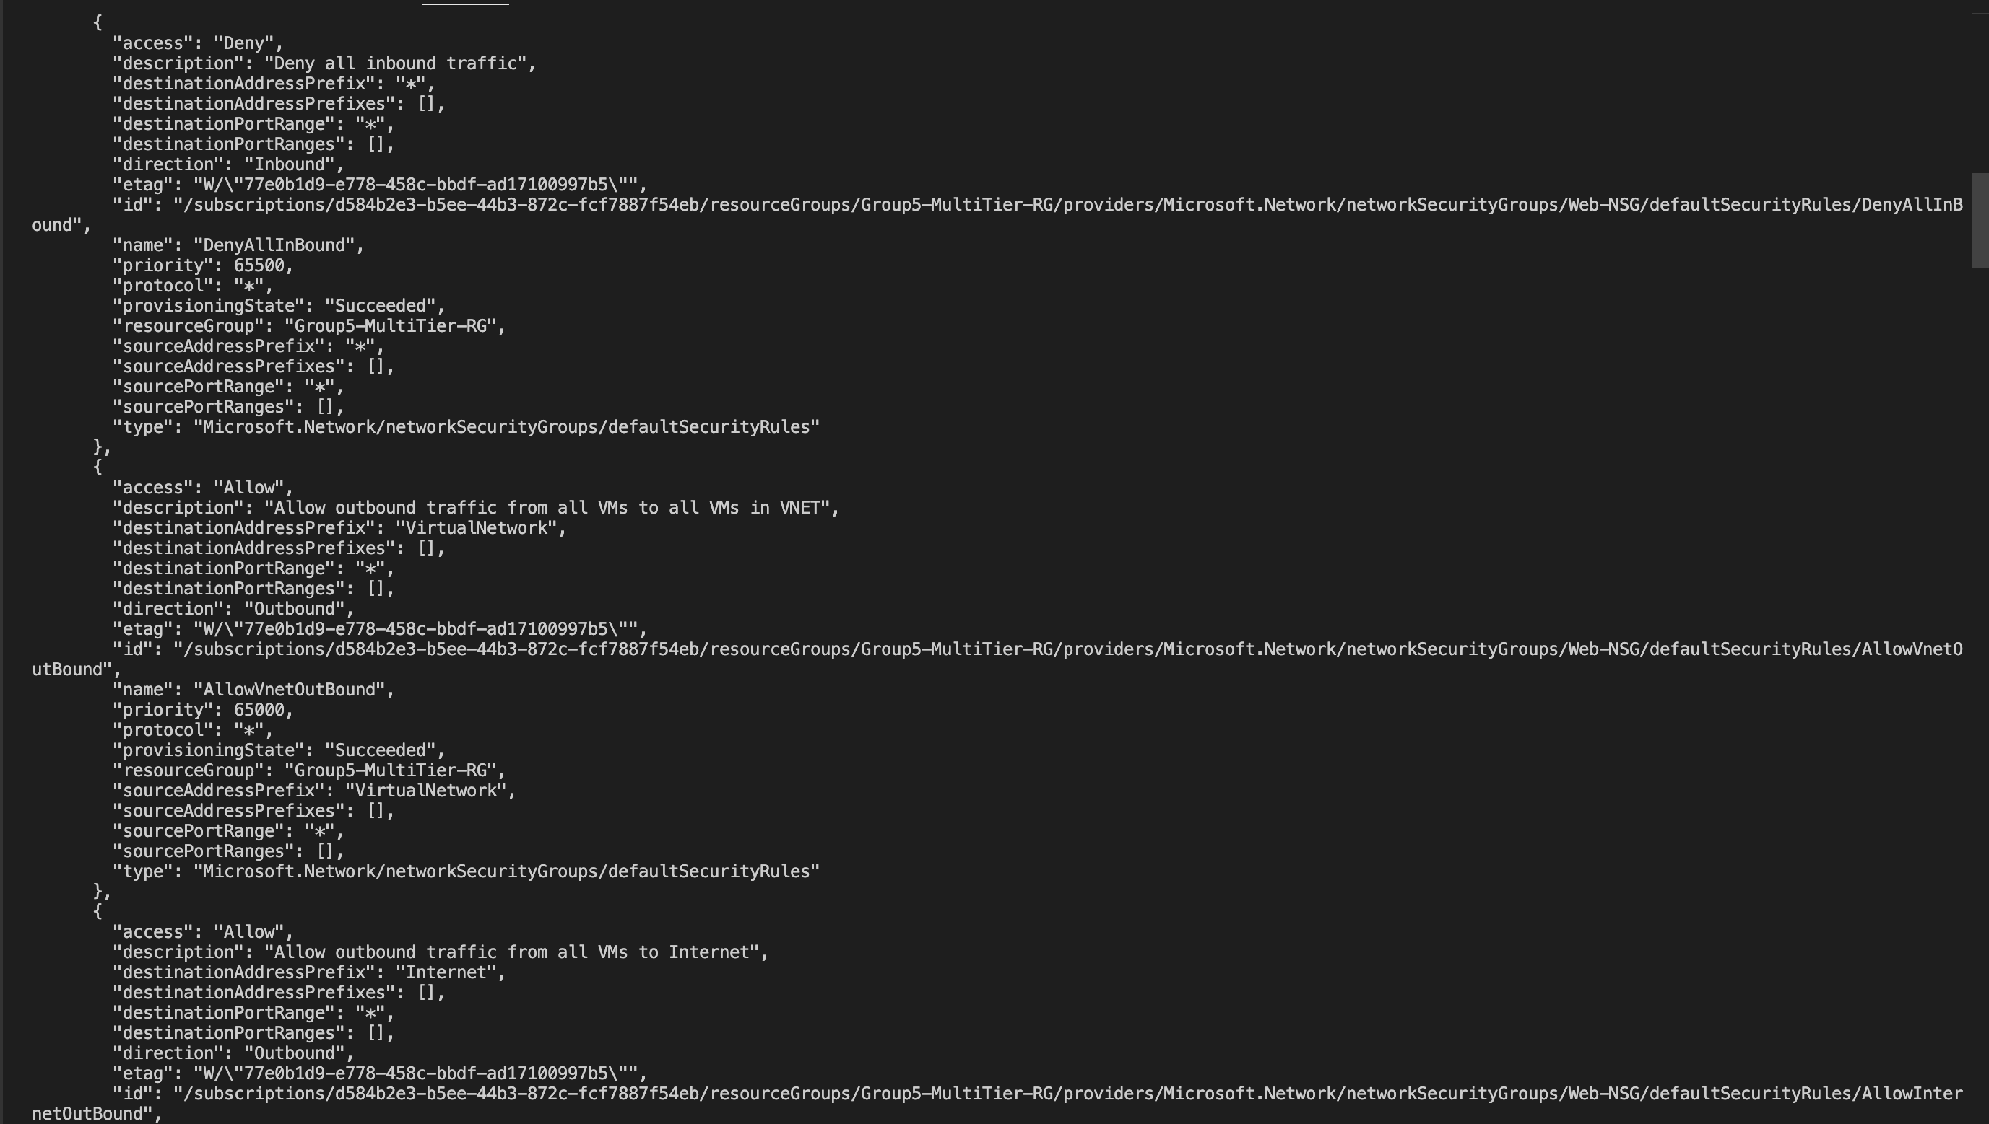

Slide 11
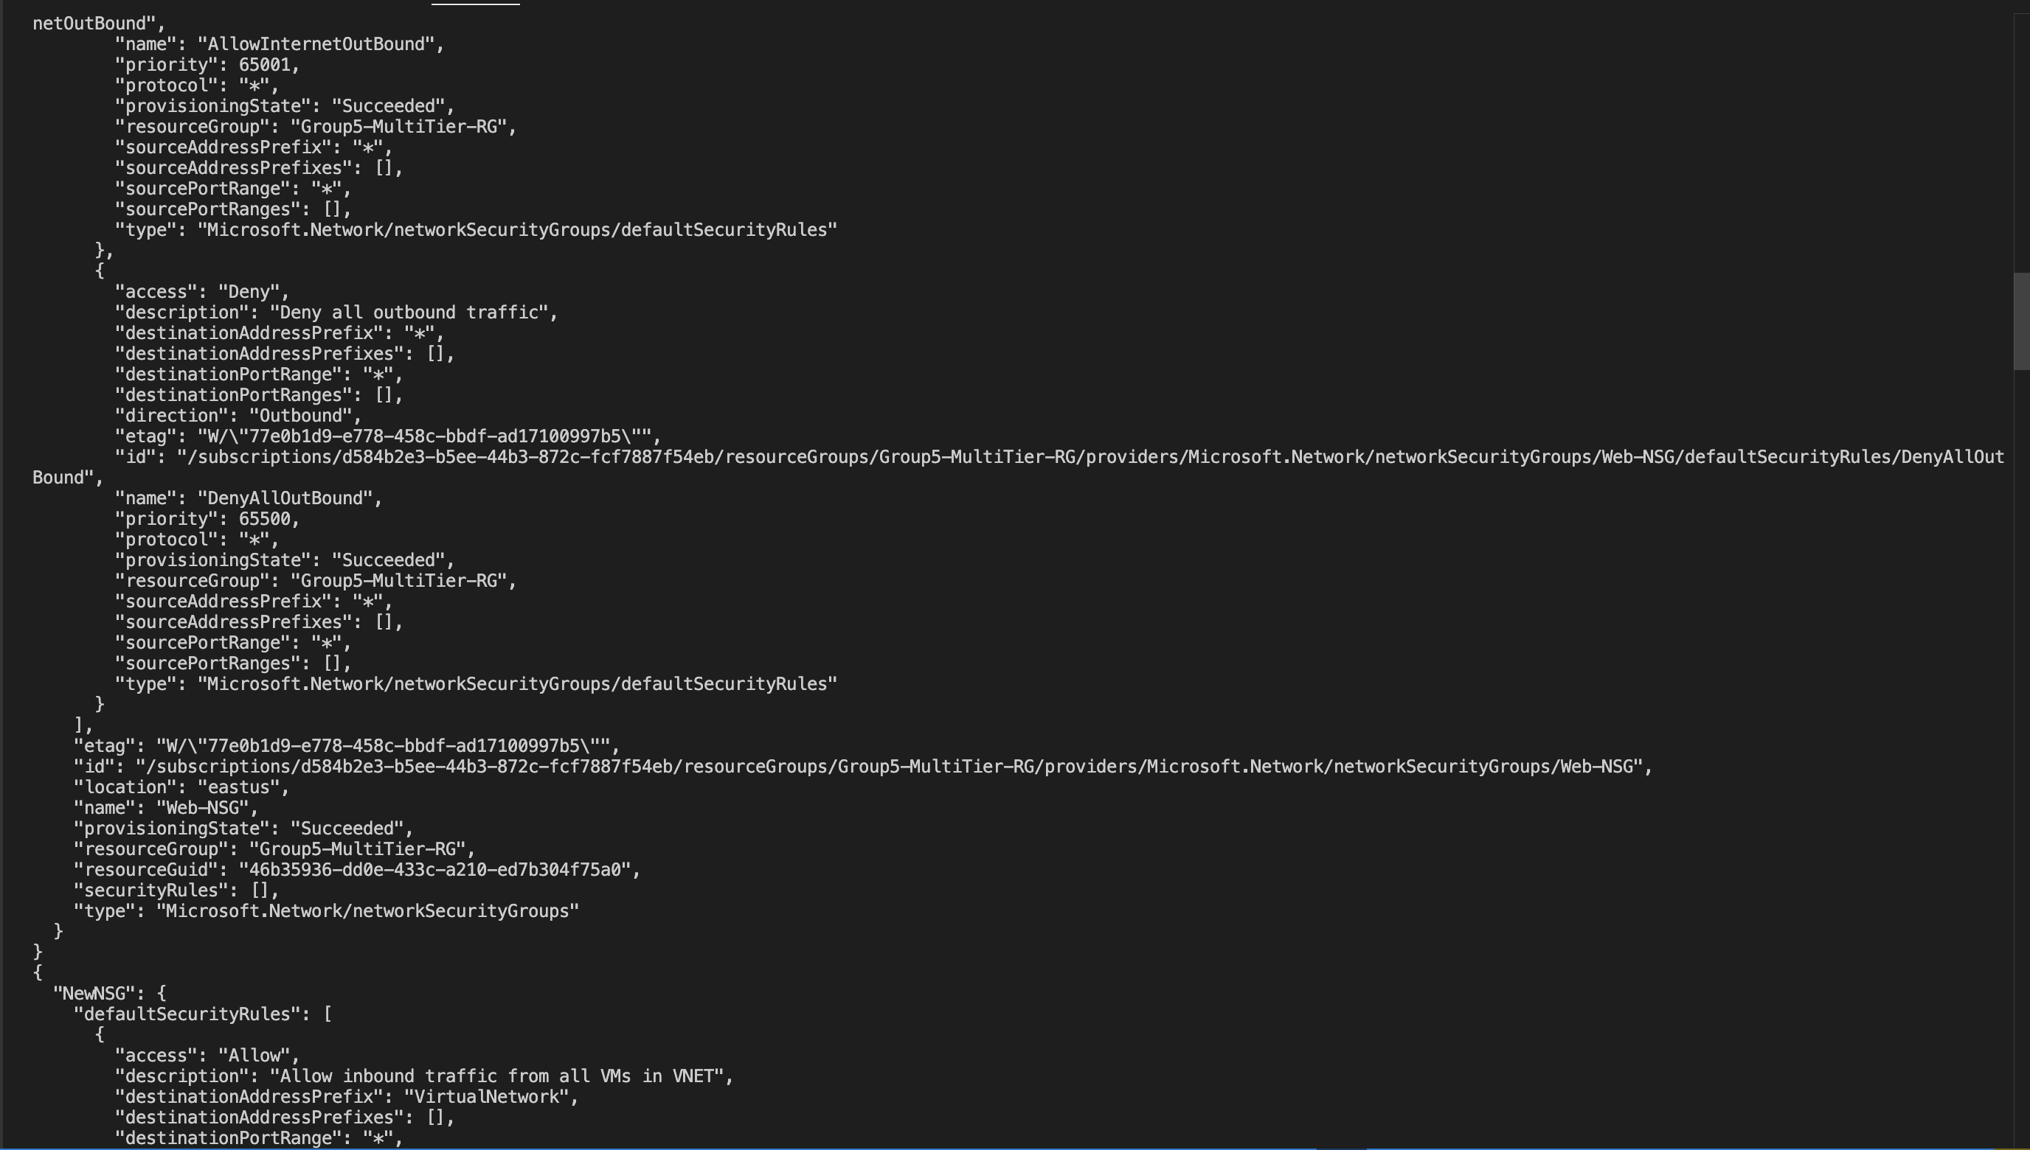

Slide 12
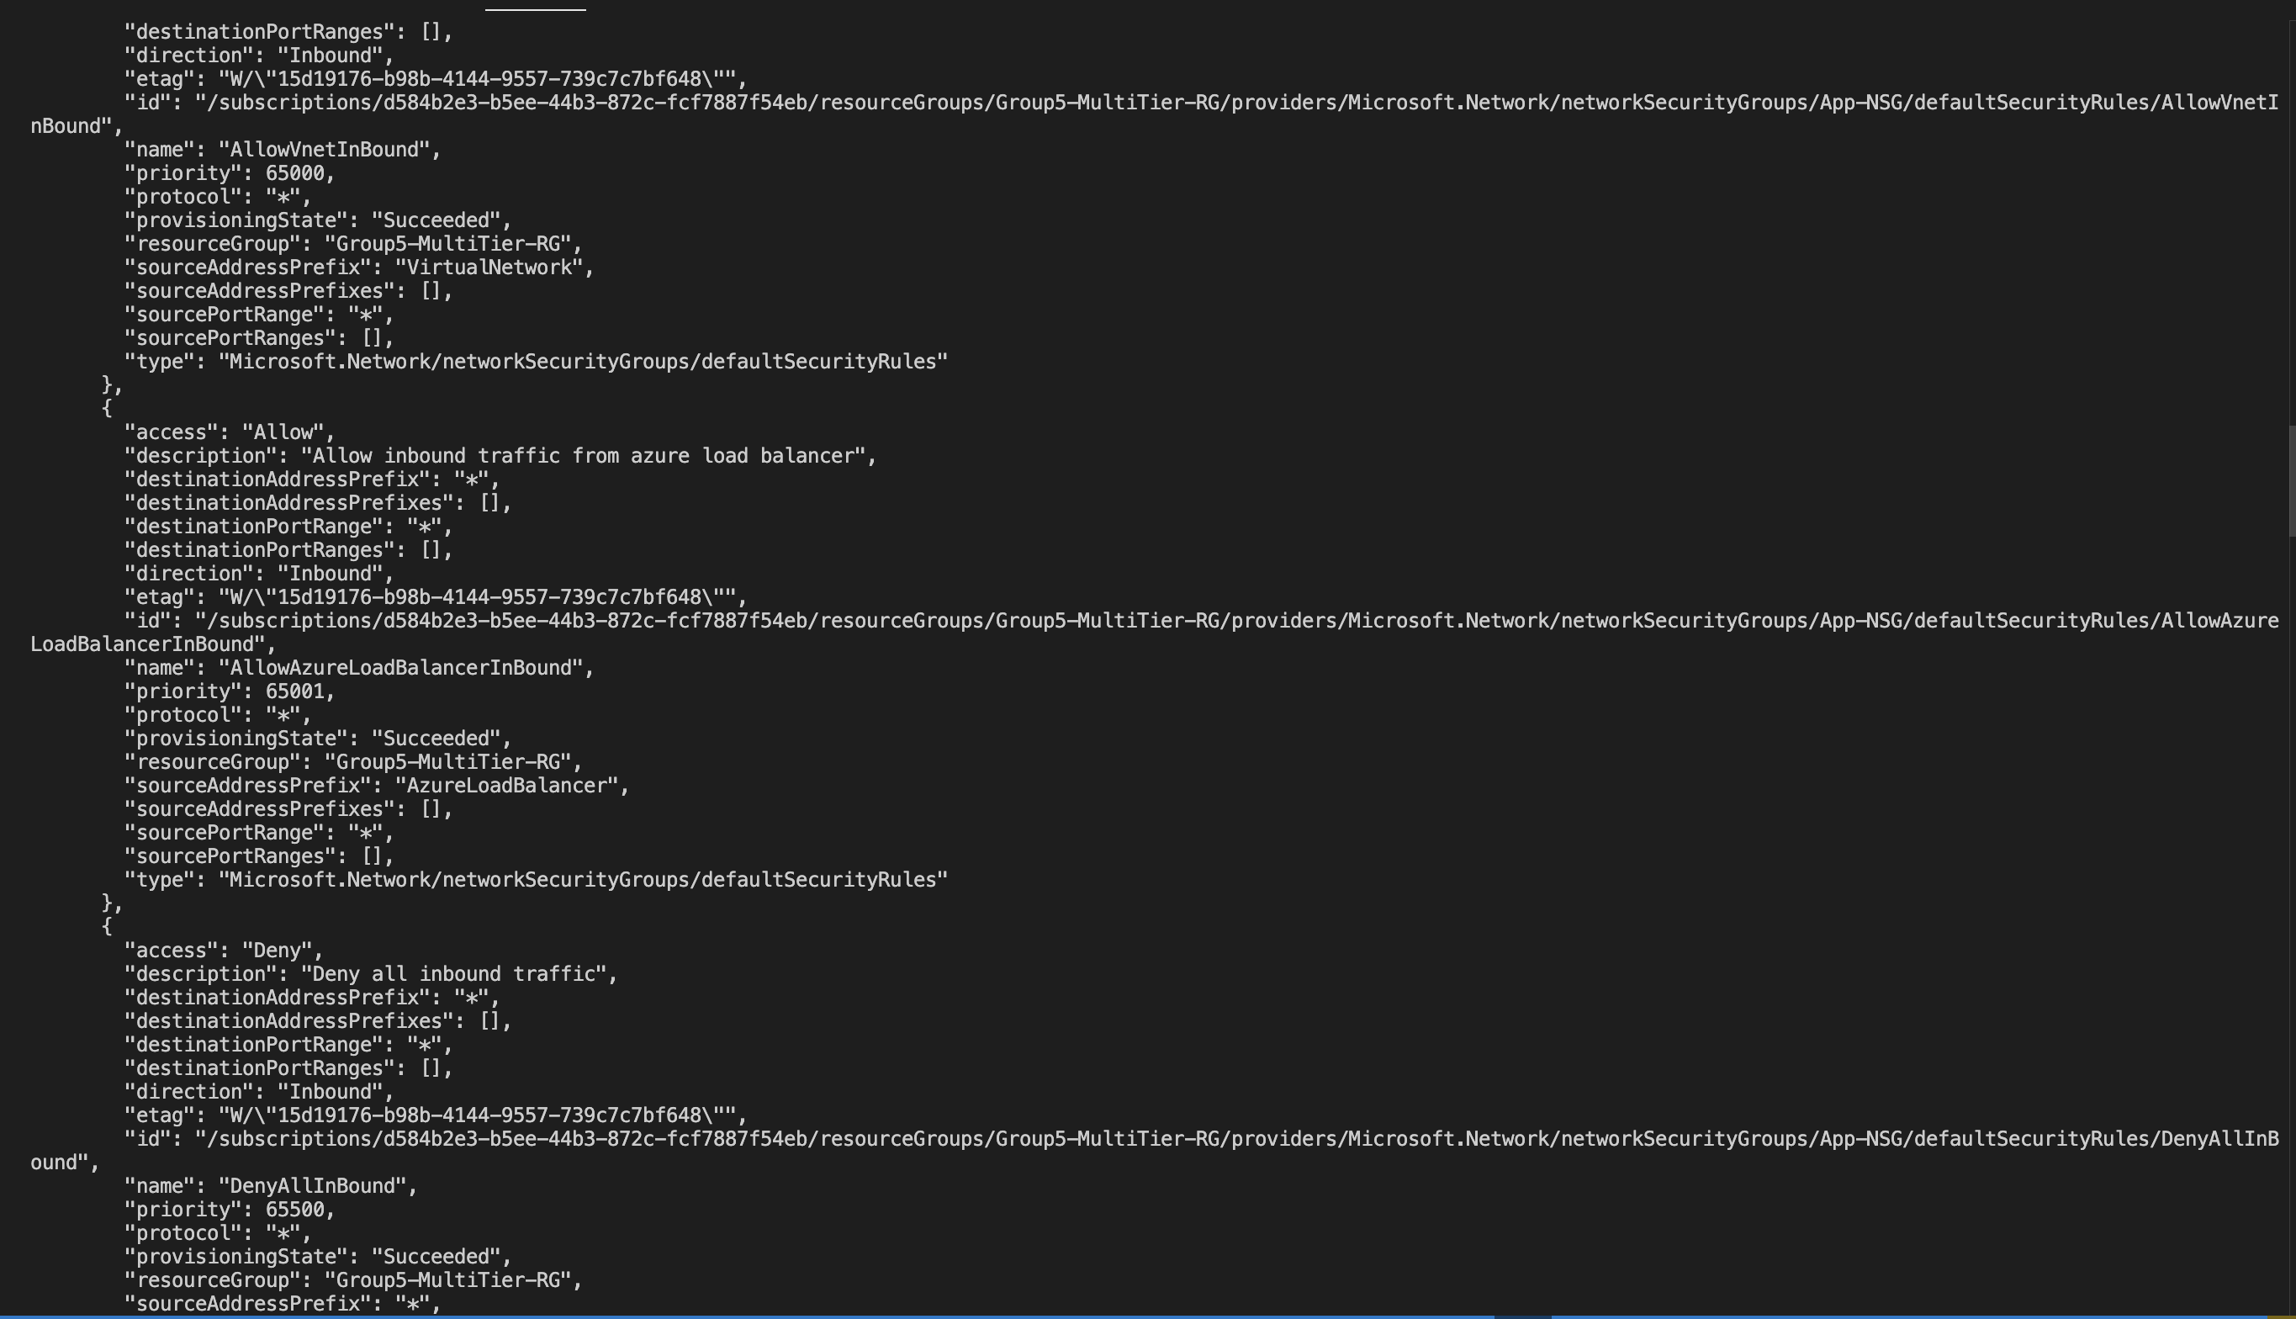

Slide 13
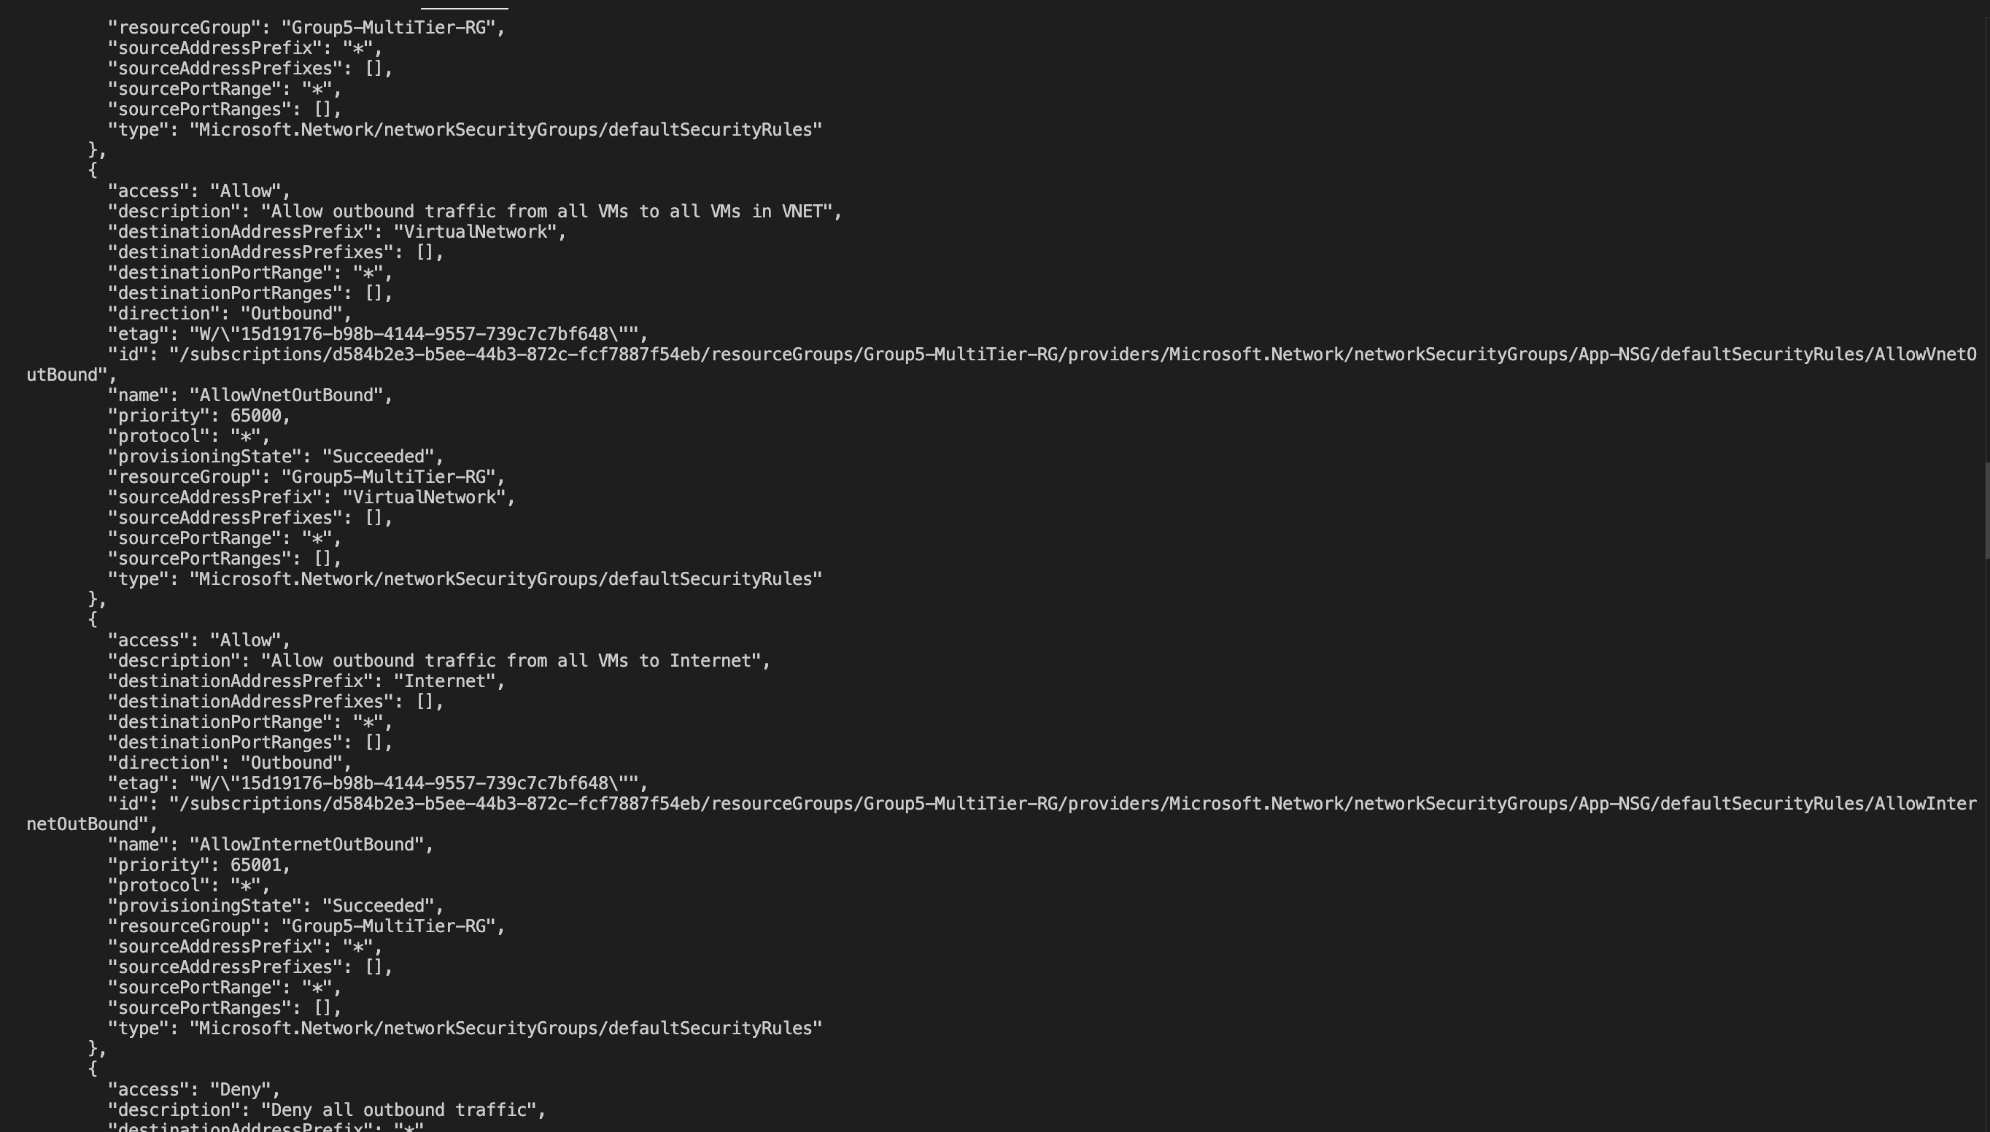

Slide 14
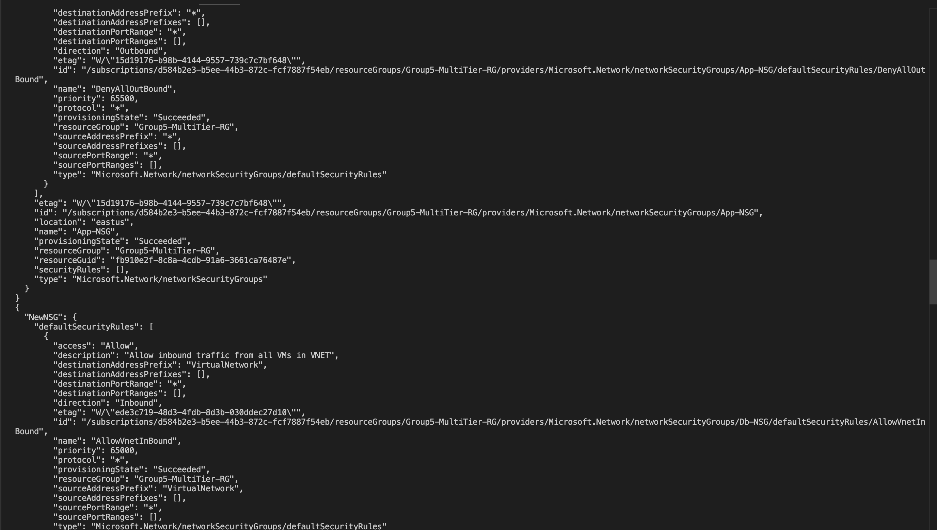

Slide 15
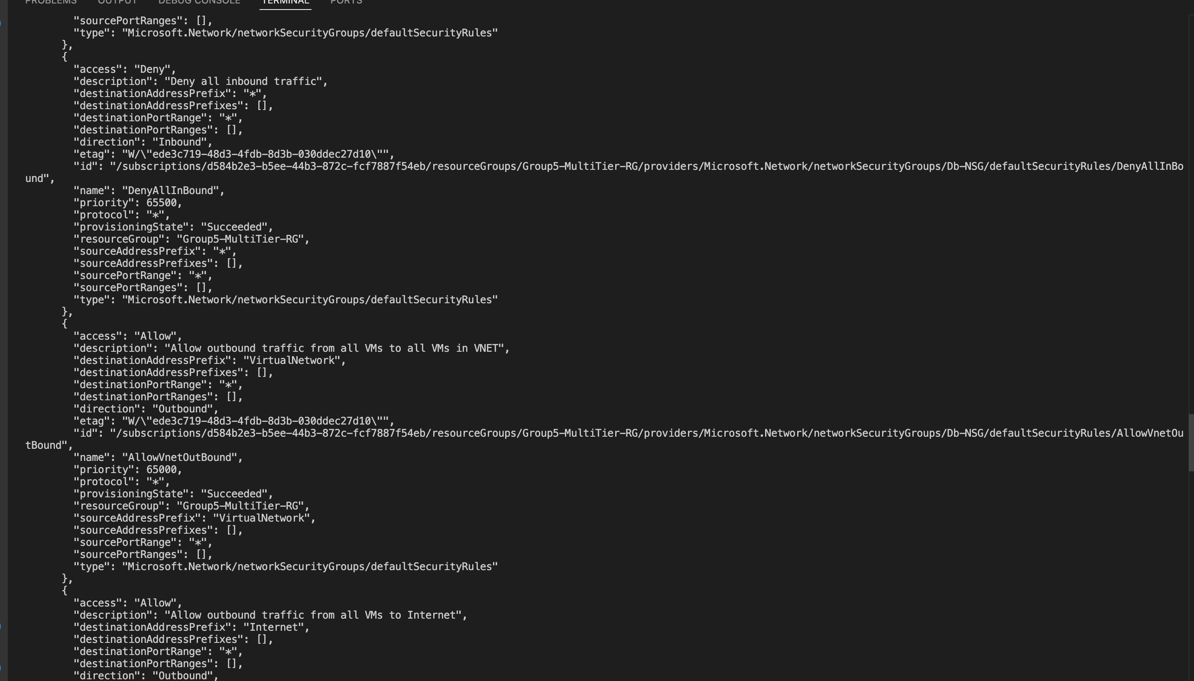

Slide 16
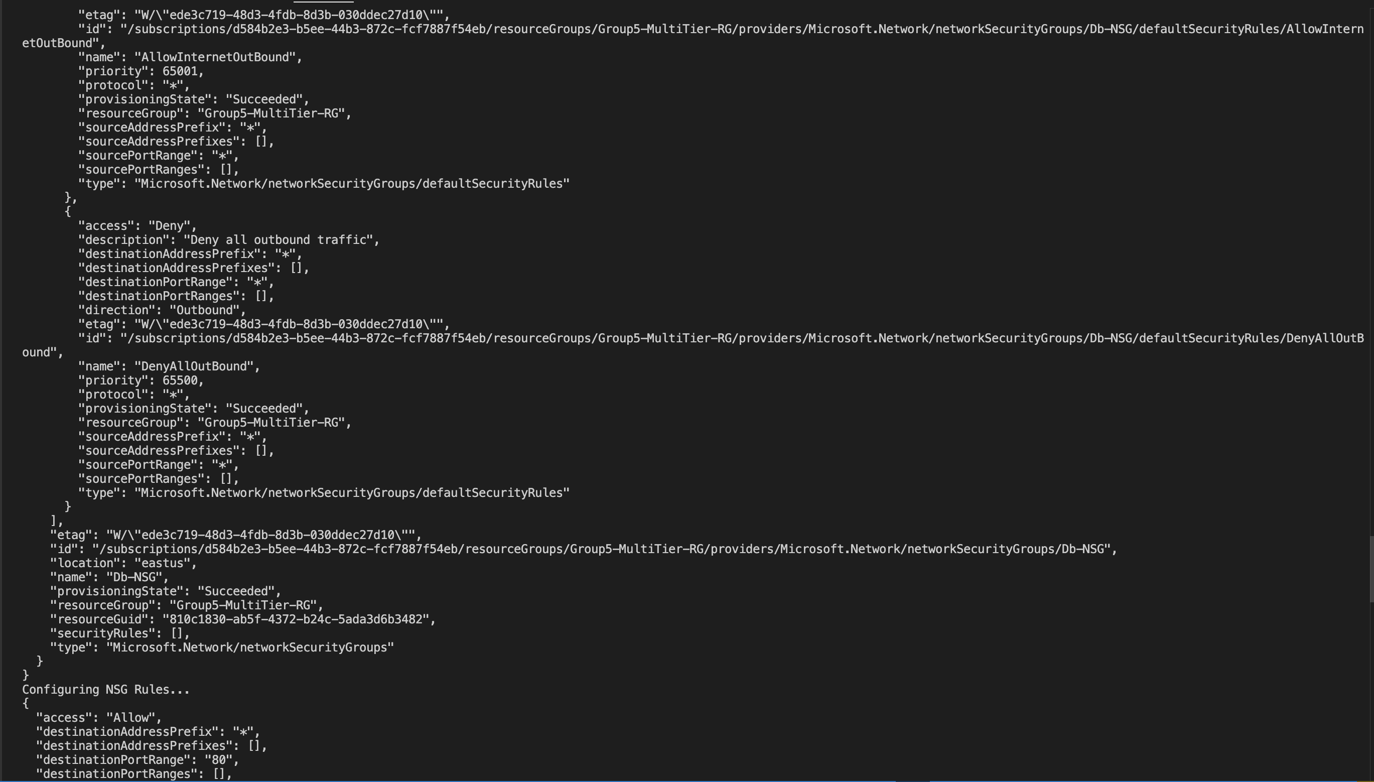

Slide 17
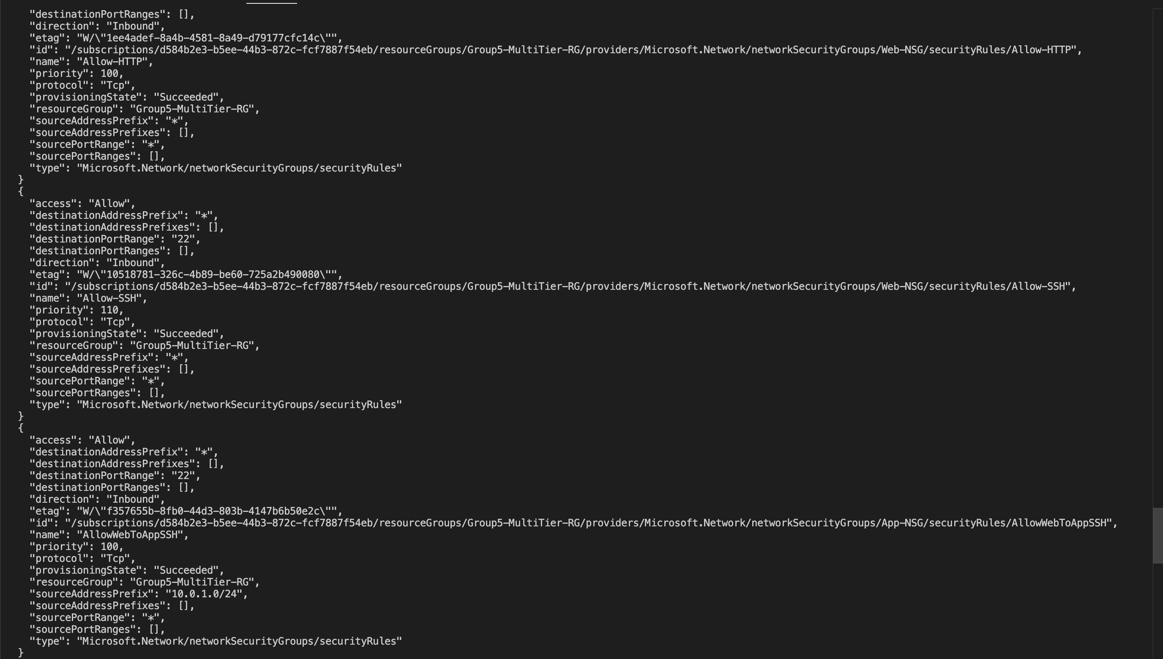

Slide 18
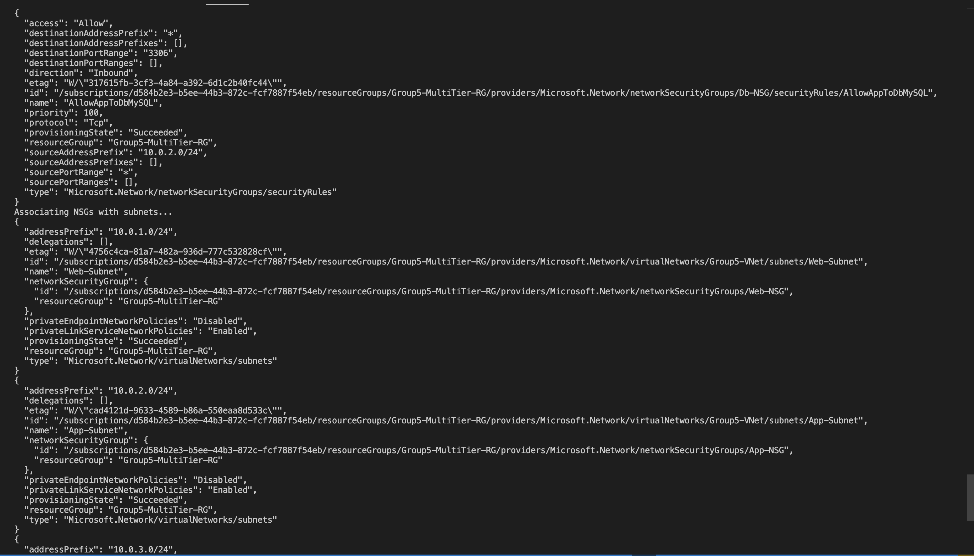

Slide 19
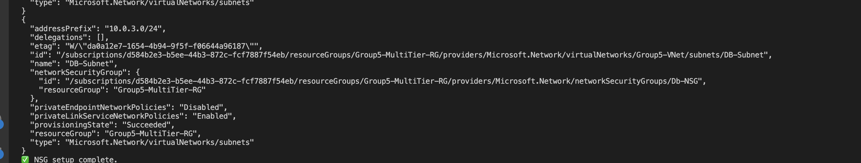

Slide 20
Step 3: VM Provisioning
Provisioned Ubuntu VMs in each subnet
Created Public IPs and NICs
Used SSH key for authentication
Script Used: provision-vms.sh

Slide 21
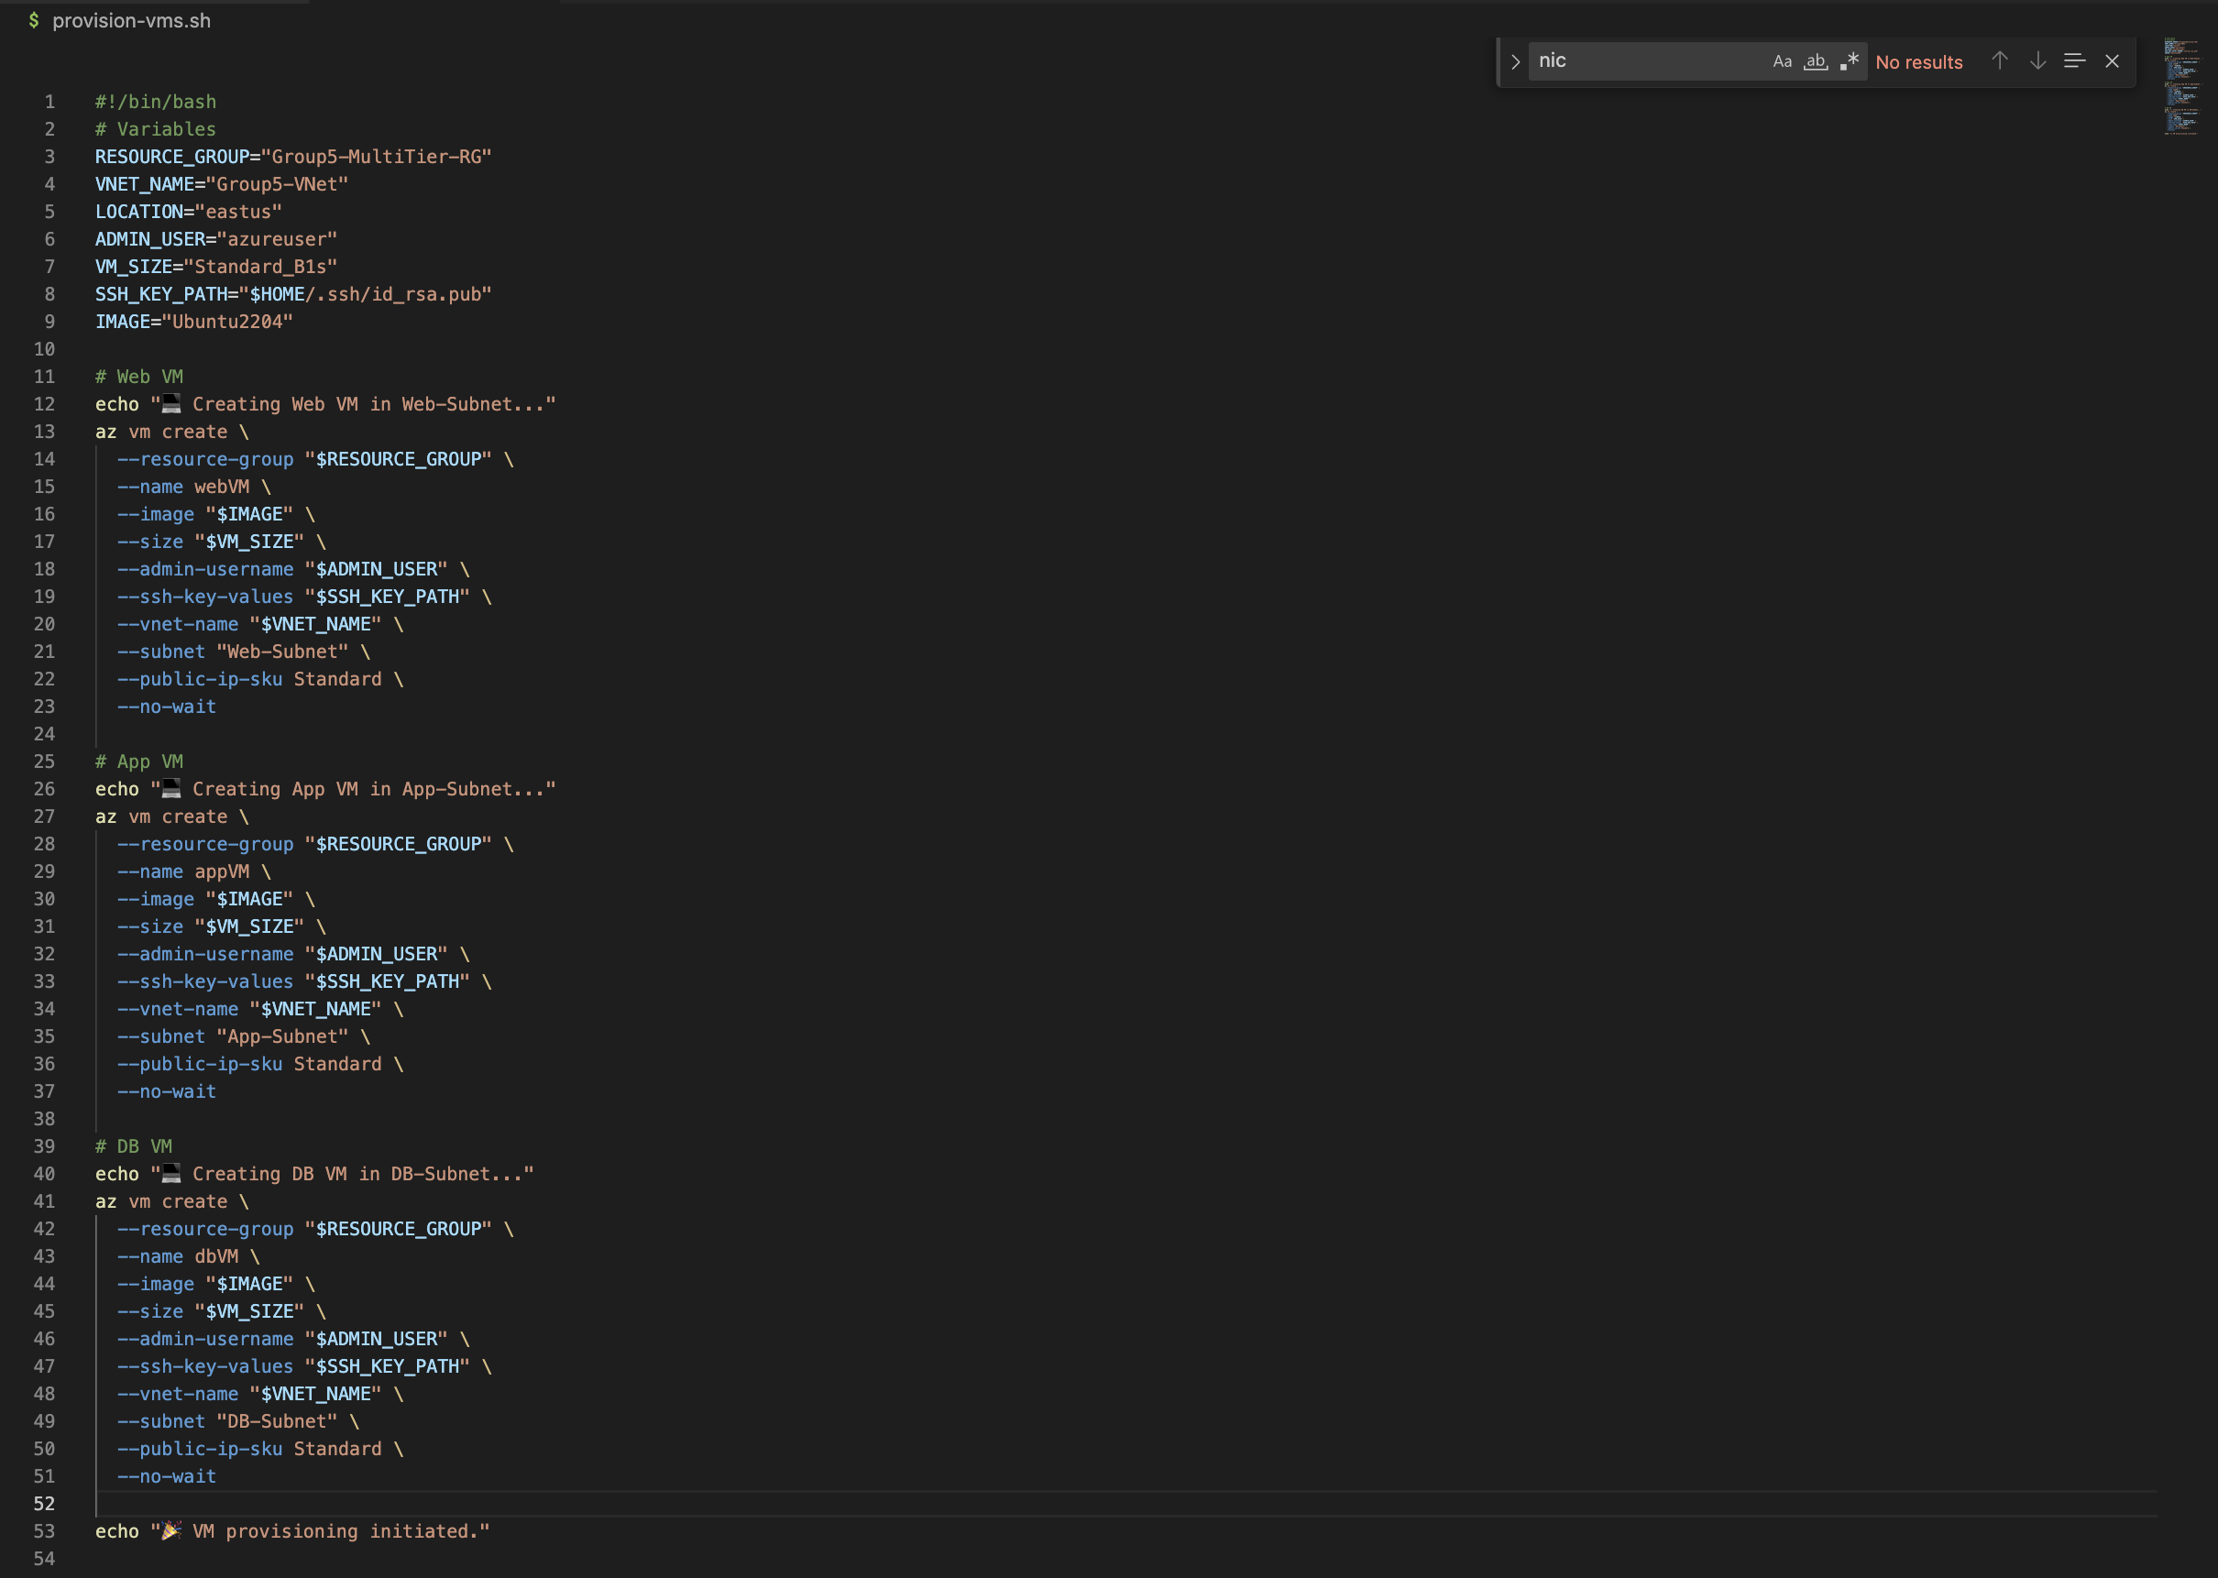

Slide 22
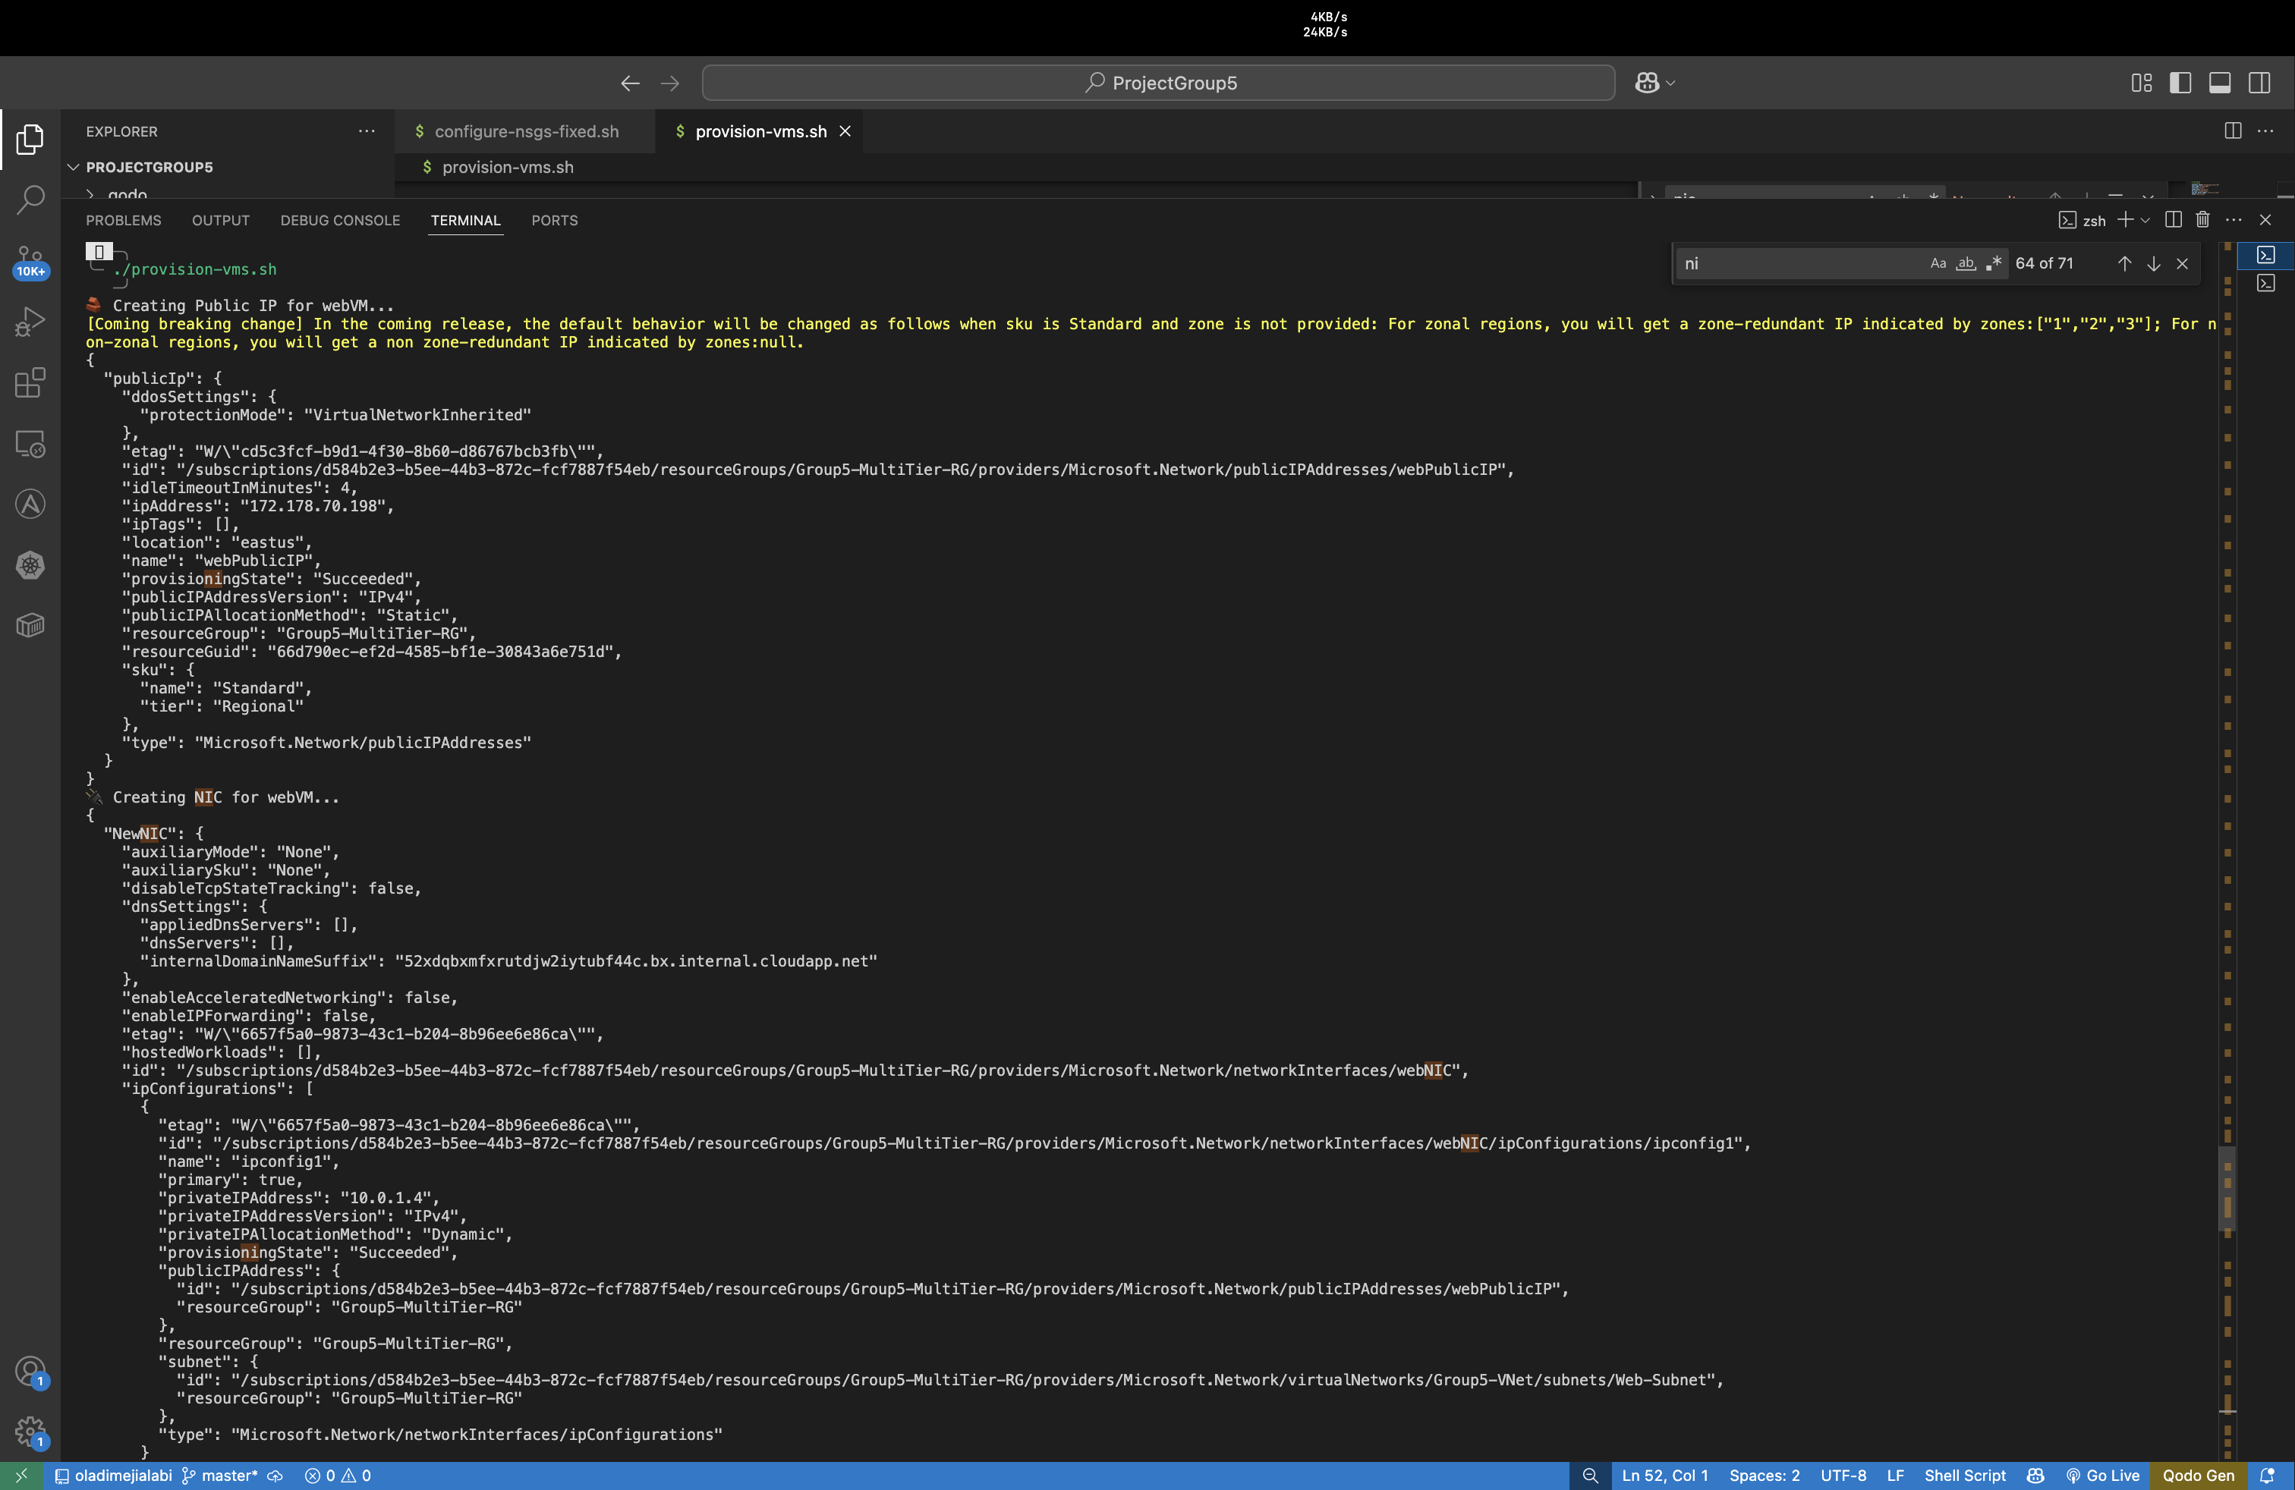

Slide 23
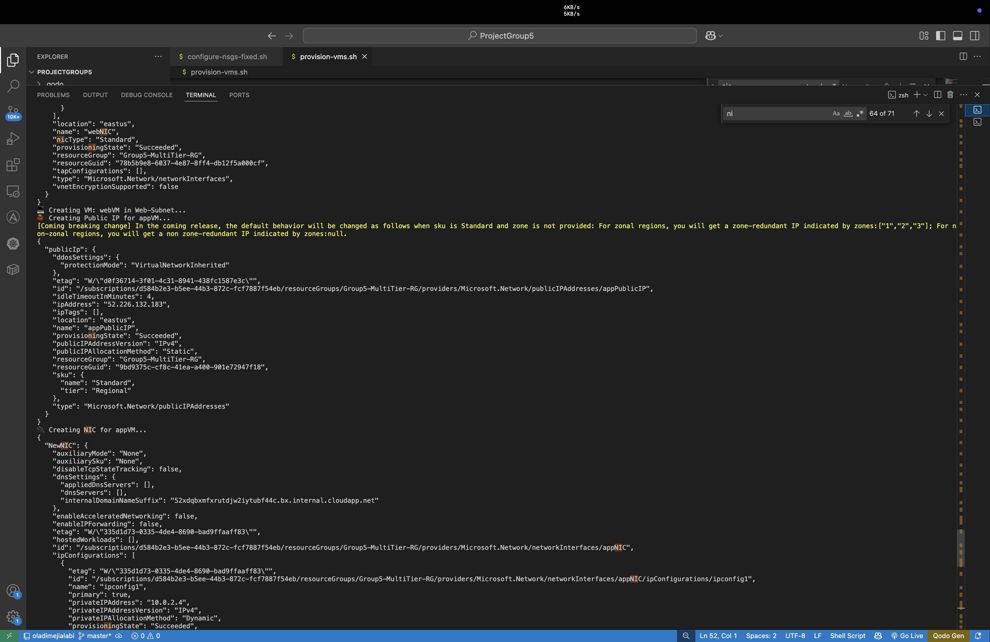

Slide 24
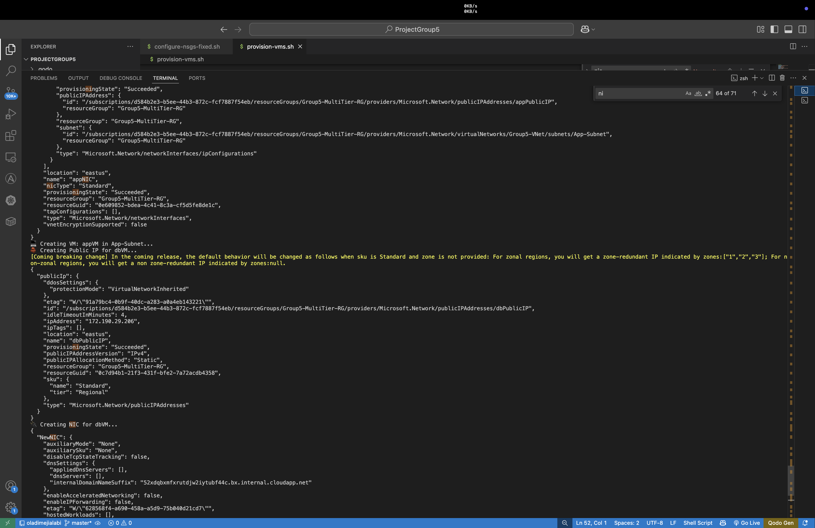

Slide 25
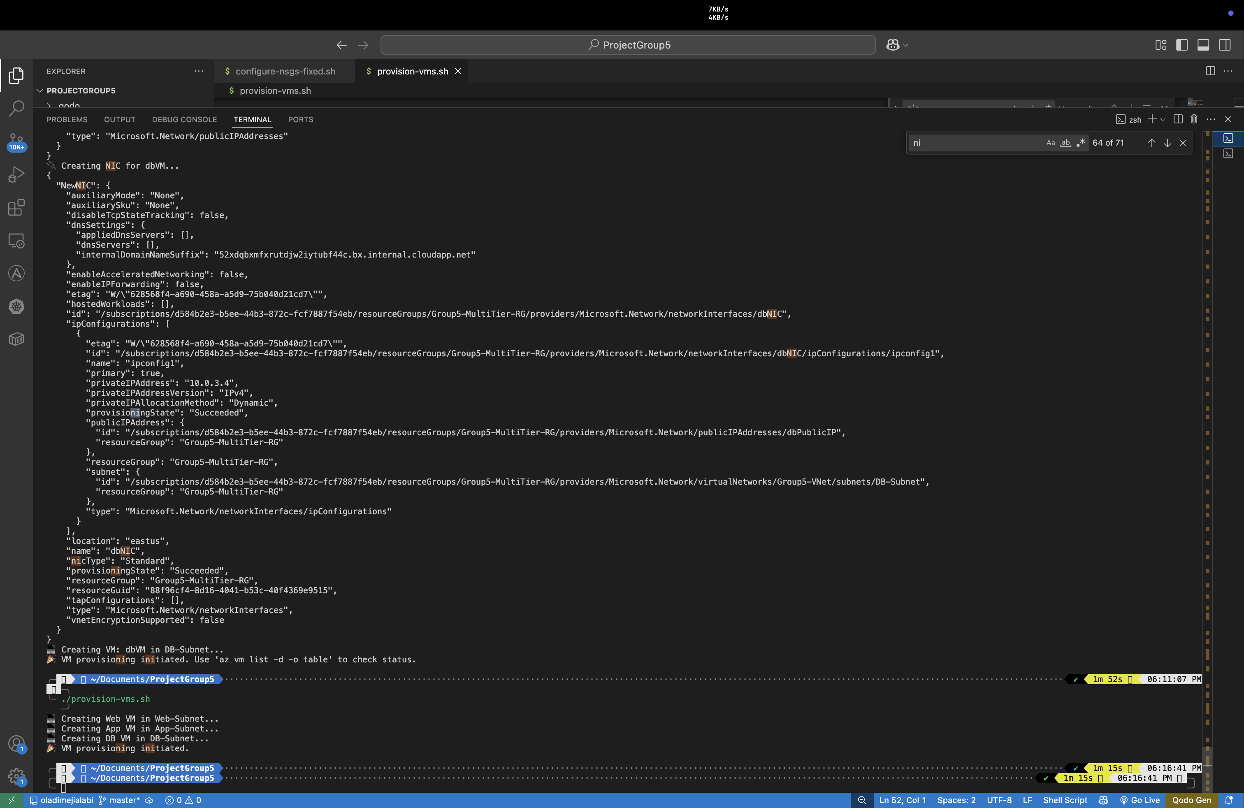

Slide 26
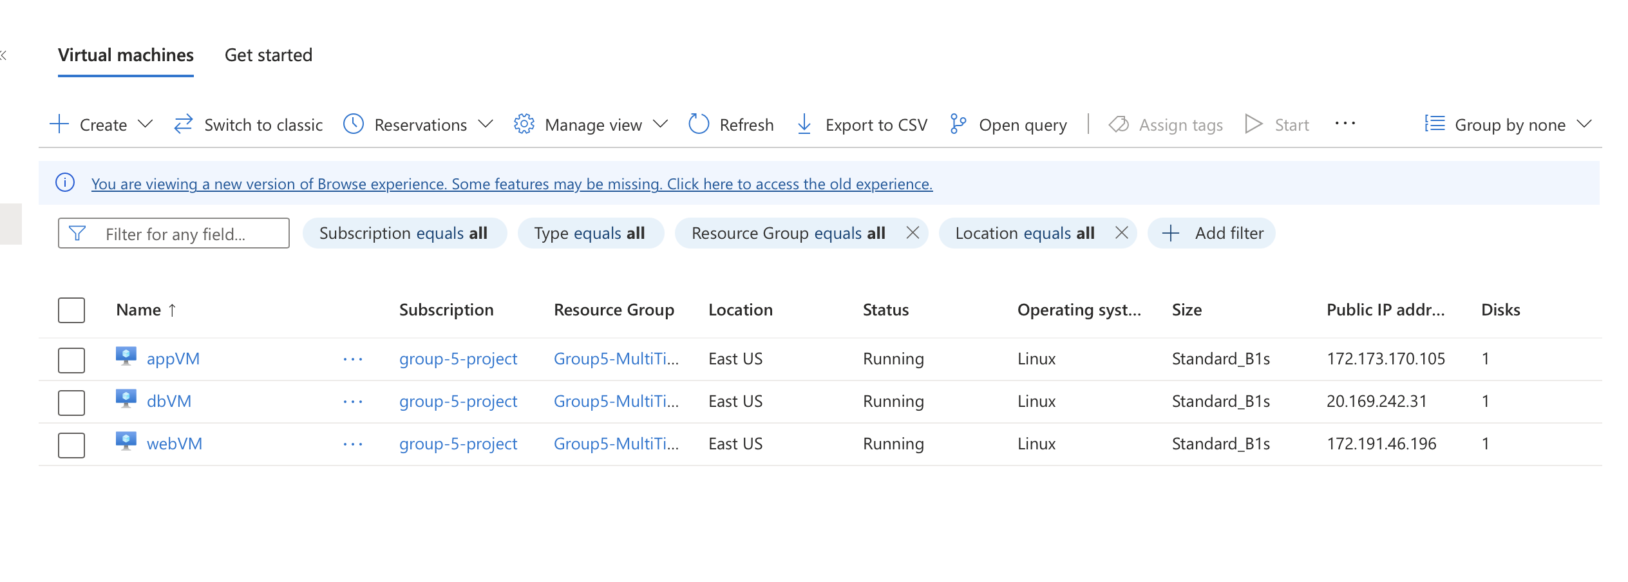

Slide 27
Step 4: Connectivity Testing
SSH into Web VM → ping App VM
SSH into App VM → telnet DB VM (port 3306)

Slide 28
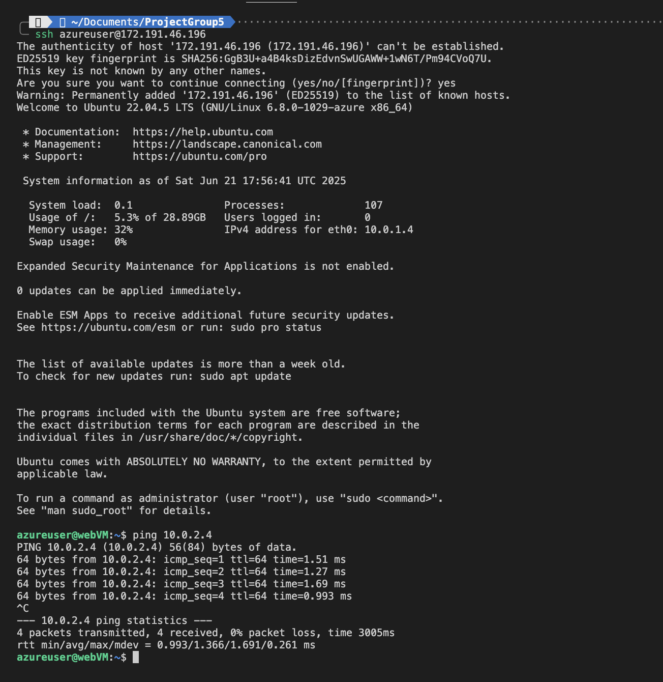
WEB VM >> APP VM

Slide 29
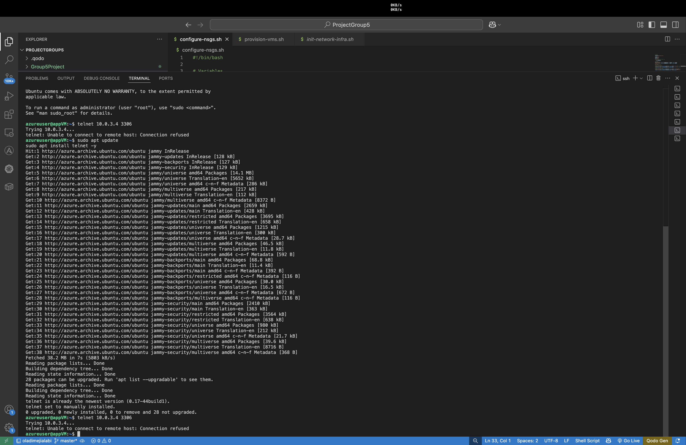
APP VM >> DB VM

Slide 30
Step 5: Automation and GitHub
Scripts modularized for reuse
Final script: deploy-all.sh (optional bonus)

Slide 31
Project Deliverables
✅ Bash scripts: infra, VMs, NSGs
✅ Screenshot proof of tiered communication
✅ NSG rules and configurations
✅ GitHub repo with clean README
✅ Presentation slides for documentation

Slide 32
Thank You!
Presented by: Oladimeji Alabi
Group 5 – Capstone Project on Azure CLI
Questions & Feedback Welcome!

